Slide 1
ORM - JPA
HIBERNATE
SPRING DATA JPA
Presenter:
hoangtl (host)
huylq
hungbm
toanhv

Slide 2
CONTENT
JDBC V. Spring Data JPA
Architecture, Workflow - What is Spring Data JPA?
ORM - Feature
- Spring Data JPA vs Hibernate
JPA, JPA Architecture - @Transactional
- Some common Pitfall
Hibernate
Architecture
States of entity, Fetch types, Cascade types, Caching
Operations, Projection, Transaction

Slide 3
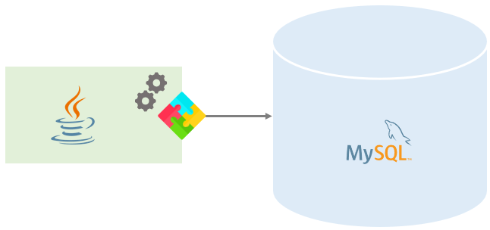
I. JDBC
Java Database Connectivity is an API for Java:
Establish a connection with a data source
Send queries and update statements to the datasource
Process the results
Released by Sun Microsystems in 1997
Java Application
JDBC
Database
Notes:
https://en.wikipedia.org/wiki/Java_Database_Connectivity#:~:text=Java%20Database%20Connectivity%20(JDBC)%20is,Edition%20platform%2C%20from%20Oracle%20Corporation.

Slide 4
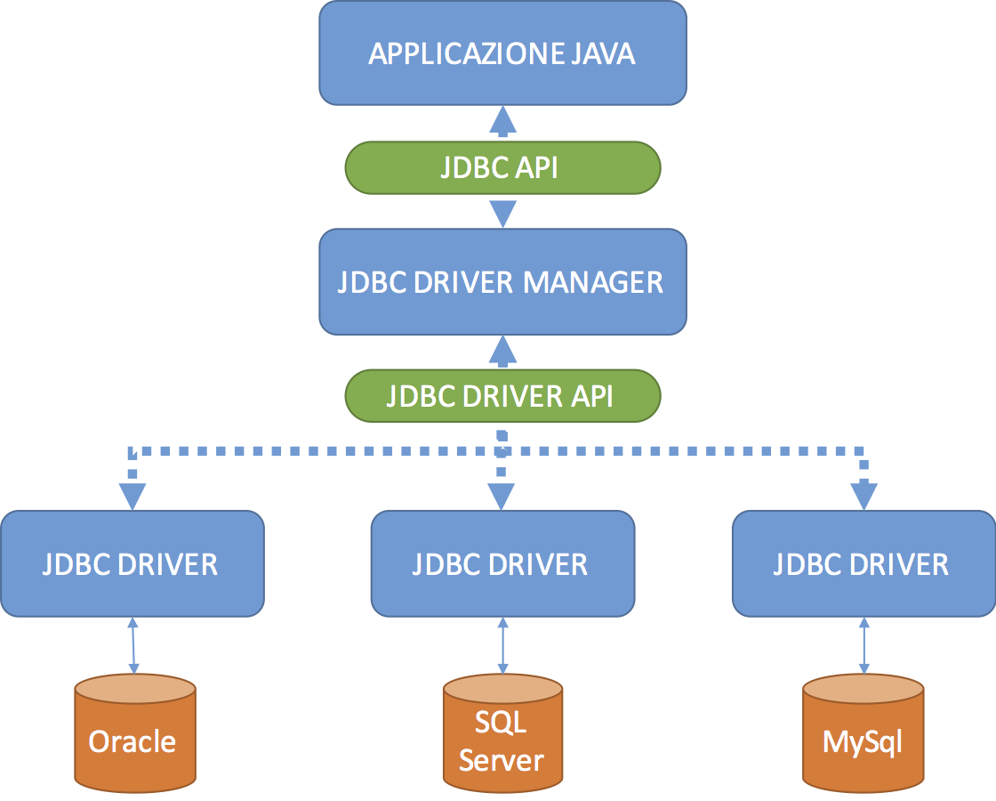
I. JDBC: Architecture
JDBC API: allows Java program to execute SQL statements and retrieve results
Driver Manager: uses database-specific driver to perform database connection
Notes:
JDBC API: connection từ application đến JDBC Driver Manager (Là các class để thực hiện connection)
JDBC Driver API: connection từ JDBC Driver Manager đến các JDBC Driver (Mỗi DB yêu cầu một Driver khác nhau)

Slide 5
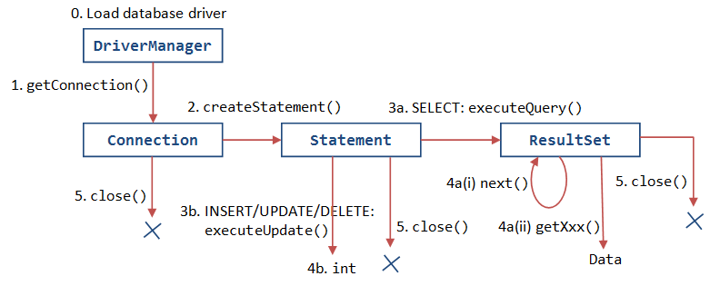
I. JDBC: Workflow
Notes:
Load driver và tạo connection
Viết và thực hiện các câu query để thao tác với dữ liệu trong DB
Đóng connection để tiết kiệm tài nguyên

Slide 6
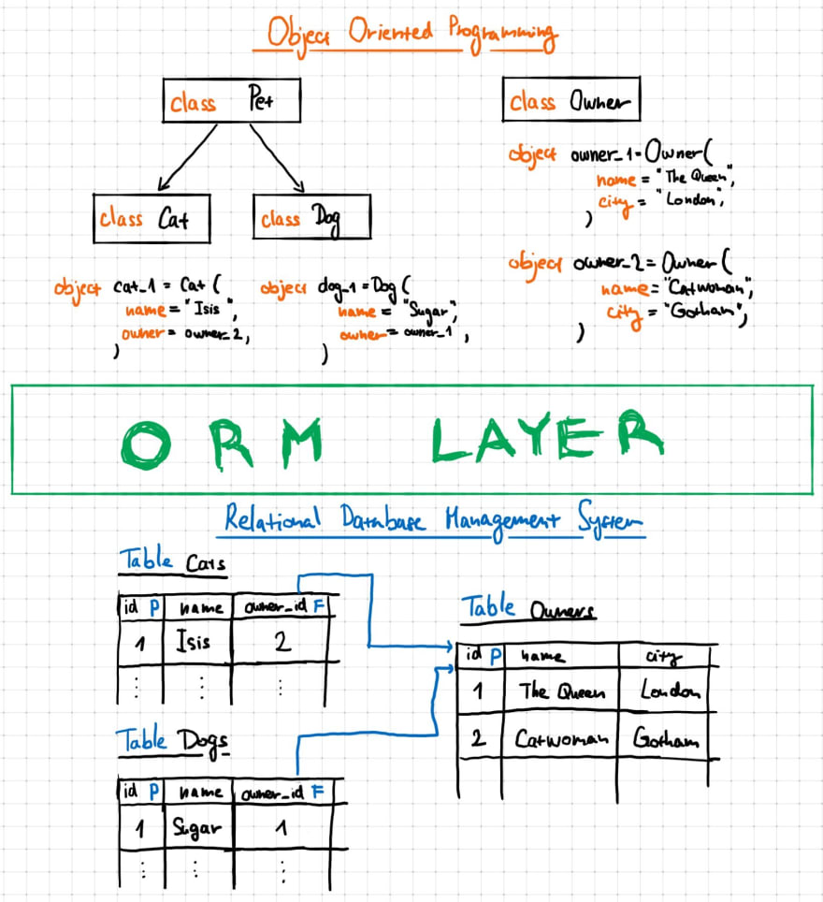
II. ORM
Object Relational Mapping
Programming technique to map application domain model objects to the relational database tables and vice versa
Notes:
Nhiều DB không lưu trữ theo hướng đối tượng → Làm sao để lưu trữ các thuộc tính của một object là các object khác? Quan hệ giữa các object?
ORM là kỹ thuật giúp chuyển đổi các object thành dạng tối giản để có thể lưu trữ trong DB nhưng vẫn giữ được các thuộc tính, quan hệ giữa các object nhằm load lại được các object đó từ DB khi cần
https://en.wikipedia.org/wiki/Object%E2%80%93relational_mapping

Slide 7
III. JPA
Java Persistence API (JPA) is the Java standard for mapping Java objects to a relational database
Third parties developed many Java ORM libraries/frameworks (Hibernate, TopLink, JDO) → Applications using ORM technology become tightly coupled with a specific vendor → Need a standard persistence API
JCP gathered the best of all these tools and released JPA 1.0 (2006), JPA 2.0 (2009), JPA 2.1 (2013), JPA 2.2 (2017), Jakarta Persistence 3.0 (2020)
JPA is only the specification and not the implementation
Notes:
https://stackoverflow.com/questions/9881611/whats-the-difference-between-jpa-and-hibernate
https://stackoverflow.com/questions/27462185/jpa-vs-orm-vs-hibernate
https://leanpub.com/high-performance-java-persistence/read#leanpub-auto-jpa-vs-hibernate
https://dev.to/reytech-lesson/what-is-jpa-589f

Slide 8
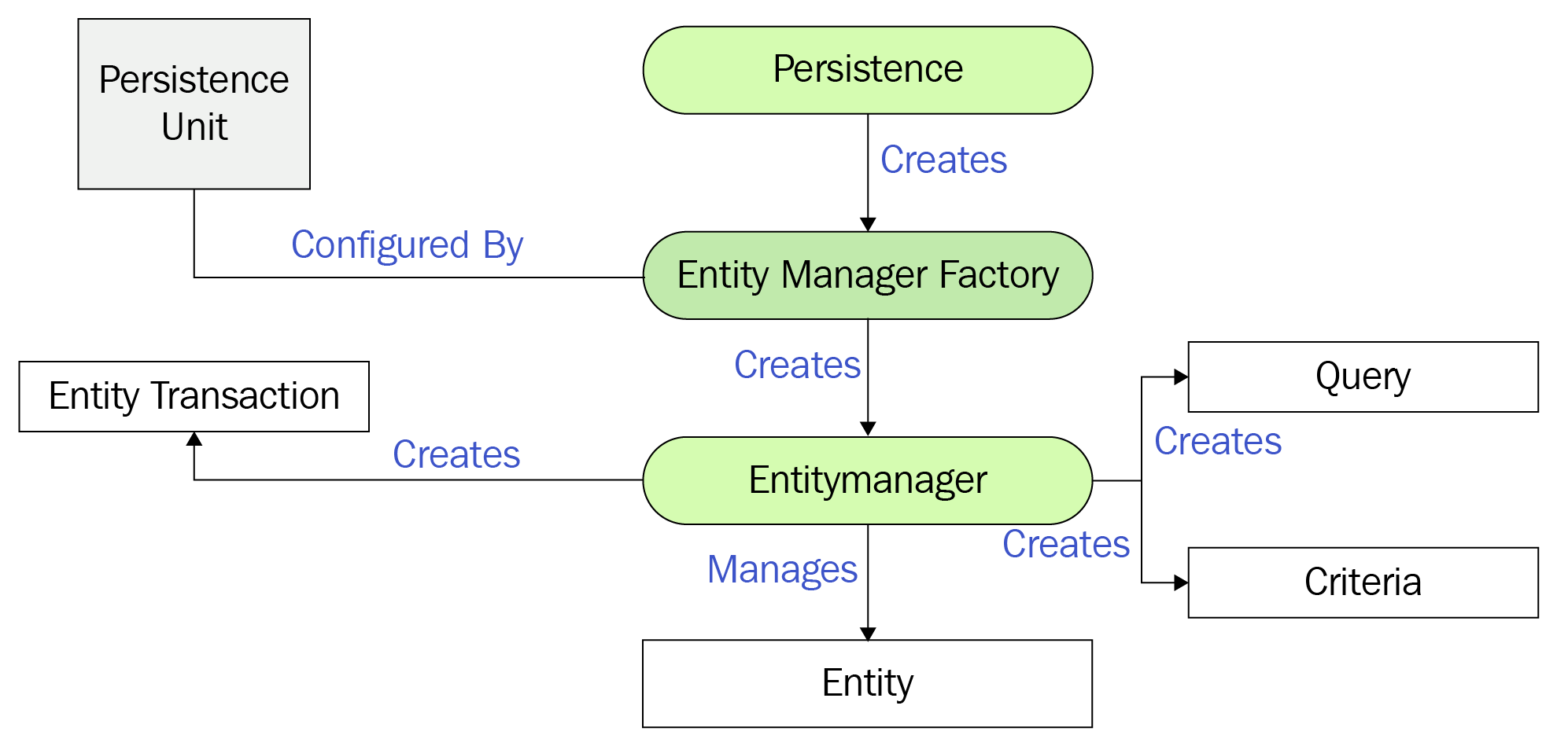
III. JPA: Architecture
Entity: persistent objects representing datastore records
Persistence: contain static helper methods to obtain Entity Manager Factory instance
Entity Manager Factory: Factory class for Entity Manager
Entity Manager: manage set of entities, APIs to manipulate entities, factory class for Query
Entity Transaction: group operations on persistent data into units of work
Query: implemented by each JPA vendor
Notes:
https://openjpa.apache.org/builds/1.2.3/apache-openjpa/docs/jpa_overview_arch.html

Slide 9
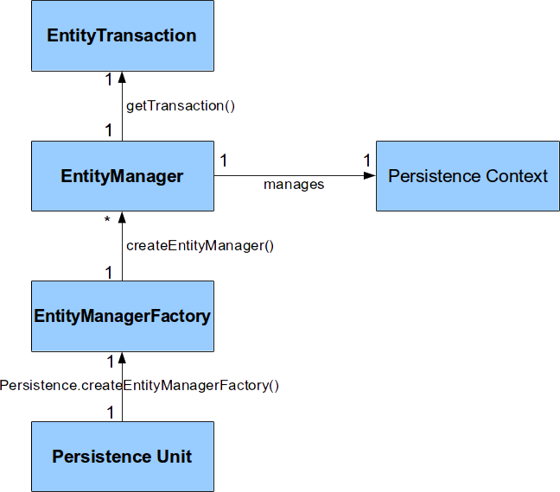
III. JPA: Architecture Relationship

Slide 10
IV. Hibernate
Open source Java-based ORM tool developed by Red Hat, released in 2001, distributed under GNU Lesser General Public License 2.1
Java applications use Hibernate APIs to load, store, query,... its domain data into datastore
Hibernate is a JPA Provider (It implements JPA specification since JPA 2.0)
Hibernate retains its native API for both backward compatibility and to accommodate non-standard features

Slide 11
IV. Hibernate: Features
Provide ORM with different strategies (multiple-objects to single-row mapping)
Support lazy initialization with numerous fetching strategies
Provide session-level cache and optional second-level cache
Automatic generation of the primary key
Support detached object concept
Automatic Dirty Checking mechanism
Polymorphic associations, bi-directional association
Provide different object-oriented query languages: HQL, JPQL
Notes:
https://www.educba.com/what-is-hibernate/

Slide 12
IV. Hibernate: Why use Hibernate?
ORM Framework: maintenance is easy and cost-effective
Open source and free software
Database independent
JPA annotation support
Hibernate uses best JDBC concepts (Rowset instead of ResultSet, DataSource instead of DriverManager, batch operation, PreparedStatement)
Provide Dialect classes
Notes:
https://www.educba.com/what-is-hibernate/

Slide 13
IV. Hibernate: Disadvantages
Slower than pure JDBC
Lots of APIs to learn + Shitty documentation
Not suitable for small projects
Generate complex queries with many joins
Notes:
https://www.educba.com/what-is-hibernate/

Slide 14
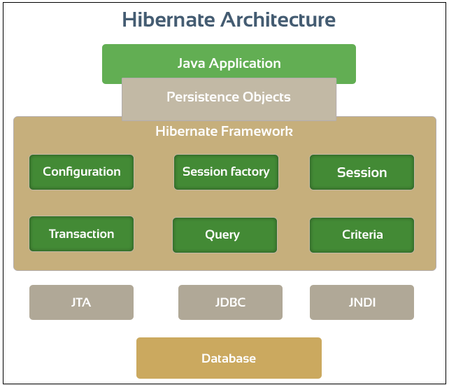
IV. Hibernate: Architecture
implements
JPA
Hibernate

Slide 15
IV. Hibernate: Persistence Context
A cache of managed entity instances. All entities in persistent state and managed in a unit of work are cached in this context
Within the persistence context, the entity instances and their lifecycle are managed.
In Hibernate, 1 Session has 1 internal persistence context
The persistence context is useful for:
automatic dirty checking and transactional write-behind.
use the persistence context as a first-level cache. -> repeatable read
guarantee a scope of Java object identity.
Notes:
ORM software must have a strategy for detecting which persistent objects have been modified by the application. -> auto dirty check
Modifications that have not yet been propagated to the db is considered dirty
write-behind Hibernate propagates changes as late as possible -> keep lock times in db as short as possible (avoid possible deadlock)
Hibernate is told to load an object by primary key (a lookup by identifier), it can first check the persistence context for the current unit of work. If the entity is found there, no database hit occurs—this is a repeatable read for an application

Slide 16
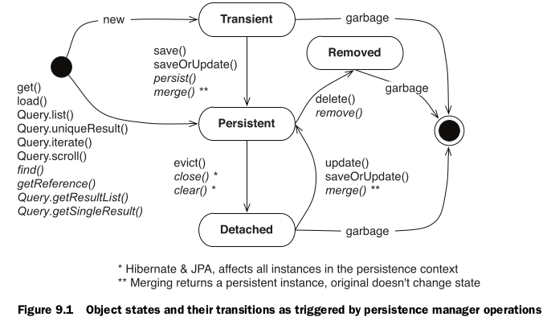
IV. Hibernate: States of entity
Notes:
(DEMO)
Objects instantiated using the new operator -> not associated with any db, row. Transient entities exist in heap memory as normal Java objects. Hibernate does not manage transient entities or persist changes done on them. Non-transactional -> Hibernate doesn’t provide rollback for transient objects
An entity instance associated with a persistence context and have a database identity. Changing to such entity would automatically be detected and propagated to the db during Session flush-time
a detached instance is an object that has been persistent, but its Session has been closed. It has a persistent identity and can have a corresponding row in the database. For detached instances, Hibernate does not guarantee the relationship between persistent identity and Java identity.
A removed entity is only scheduled for deletion and the actual database DELETE statement will be executed during Session flush-time

Slide 17
IV. Hibernate: States of entity
Transient
A newly created object, not associated with a Hibernate Session or any db table row
Non-transactional -> Hibernate doesn’t provide rollback for transient objects
Persistent
An entity instance associated with a persistence context and have a database identity
Changing to such entity would automatically be detected and propagated to the db during Session flush-time
Detached
An object that has been persistence but its persistence context is closed
It has a persistent identity and can have a corresponding row in the db
Hibernate doesn’t guarantee the relationship between persistence identity vs Java identity
Removed
A removed entity is only scheduled for deletion and the actual database DELETE statement will be executed during Session flush-time
Notes:
https://vladmihalcea.com/a-beginners-guide-to-jpa-hibernate-entity-state-transitions/

Slide 18
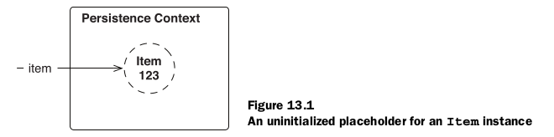
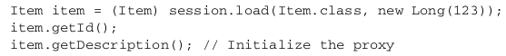
IV. Hibernate: Fetching Type
Hibernate defaults to a lazy fetching strategy for all entities and collections
Using load(), whenever Hibernate returns an instance of an entity class, it checks whether it can return a proxy instead and avoid a database hit
A proxy is initialized if you call any method that is not the identifier getter method
Notes:
(DEMO)
Hibernate will create a proxy class during runtime and will override the getter method, so that it can go to your database and fetch the record once you invoke that method
Note that call get() instead of load() you trigger a database hit and no proxy is returned

Slide 19
IV. Hibernate: Fetching Type
FetchType.EAGER strategy is a requirement on the persistence provider runtime that data must be eagerly fetched (@ManyToOne, @OneToOne)
(+) Simplicity
(-) Longer initial loading time
(-) Loading too much unnecessary data might impact performance
FetchType.LAZY strategy is a hint to the persistence provider runtime that data should be fetched lazily when it is first accessed (@OneToMany, @ManyToMany)
(+) Smaller initial load time than the other approach
(-) Might end up with LazyInitializationException

Slide 20
IV. Hibernate: Cascading
Entity relationships often depend on the existence of another entity (association)
-> Cascading is the way of performing action on both the target entity and its associated on
Should be used for *-toMany associations (the Parent entity state transition being cascaded to its Child entities)
JPA Cascade type: ALL, PERSIST, MERGE, REMOVE, REFRESH, DETACH
Hibernate Cascade type: REPLICATE, SAVE_UPDATE, LOCK

Slide 21
IV. Hibernate: Cascading
ALL - propagates all operations — including Hibernate-specific ones — from a parent to a child entity.
PERSIST - propagates the persist() operation from a parent to a child entity.
MERGE - propagates the merge() operation from a parent to a child entity.
REMOVE (DELETE in Hibernate) - propagates the remove operation from a parent to a child entity
REFRESH - the child entity also gets reloaded from the database whenever the parent entity is refreshed.
DETACH - the child entity will also get removed from the persistent context.
REPLICATE - The replicate() operation is used when having more than one data source and we want the data in sync
SAVE_UPDATE - propagates the same operation to the associated child entity. It's useful when we use Hibernate-specific operations like save, update and saveOrUpdate.
LOCK - reattaches the entity and its associated child entity with the persistent context again.

Slide 22
IV. Hibernate: Caching
In general there are three main cache scope:
Transaction scope cache: Attached and valid to the current unit of work. Data in this cache isn’t accessed concurrently
Process scope cache: Shared between many (possibly concurrent) units of work or transactions
Cluster scope cache: Shared between multiple processes on the same machine or between multiple machines in a cluster

Slide 23
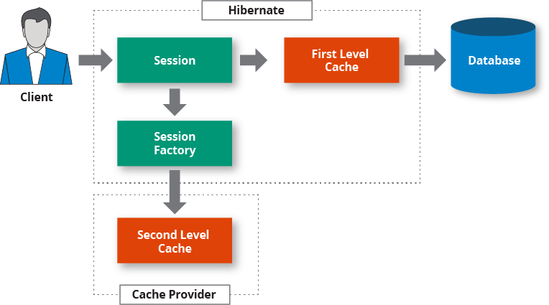
IV. Hibernate: Caching
Notes:
Phạm vi lưu trữ đối tượng được mở rộng hơn trong L2 Cache, sang mức SessionFactory thay vì Session như L1 Cache.
After returning entity from L2 cache, cache data to L1 cache

Slide 24
IV. Hibernate: Caching
First level cache
The persistence context cache. A Hibernate Session lifespan corresponds to either a single request or a conversation (transaction)
It is built in and active by default to reduce the number of SQL queries directly to the database
no sharing of cached data across sessions, and the cached data is deleted when the session closes

Slide 25
IV. Hibernate: Caching
Second level cache
The second-level cache in Hibernate is pluggable to complement the first-level cache and may be scoped to the process or cluster (share cached data among sessions)
If results are not in the first-level cache, then the second-level cache is checked
Set up Hibernate second level cache:
Choose concurrency strategy
Configure cache expiration, physical cache attributes using cache provider. (cache policies)
Notes:
A cache concurrency strategy defines the transaction isolation details for a particular item of data, whereas the cache provider represents the physical cache implementation

Slide 26
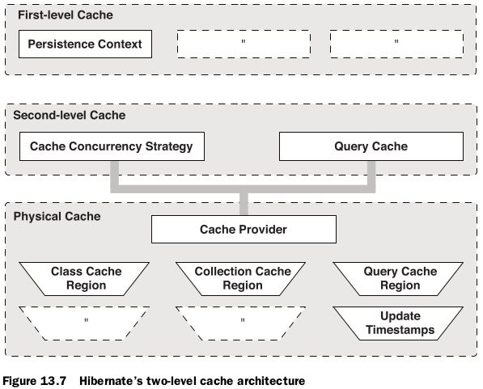
IV. Hibernate: Caching
Notes:
Hibernate also implements a cache for query resultsets that integrates closely with the second-level cache. This is an optional feature; it requires two additional physical cache regions that hold the cached query results and the timestamps when a table was last updated

Slide 27
IV. Hibernate: Caching
4 built-in concurrency strategies
Read-only
Simple, performs well, and is safe to use in a clustered environment.
Useful for data that is read frequently but never updated.
Read-write
Suitable for regular update data, more overhead than read-only
Not provide serializable transaction isolation (phantom reads can occur), but guarantees strong consistency by using ‘soft’ locks
Nonstrict read-write
Suitable for rarely update data, less overhead than read-write
do not need strict transaction isolation
Transactional
It supports only transactional cache providers such as JBoss TreeCache.
only used in the JTA environment.
Notes:
1 - Nó phù hợp cho việc đọc và lưu cấu hình ứng dụng và các dữ liệu tĩnh khác không bao giờ được cập nhật.
2 - When a cached entity is updated, a soft lock is stored in the cache for that entity as well, which is released after the transaction is committed. All concurrent transactions that access soft-locked entries will fetch the corresponding data directly from database.
3 - if it is extremely unlikely that two transactions would try to update the same item simultaneously

Slide 28
IV. Hibernate: Caching
4 Cache providers
EHCache
Fast, lightweight, easy to use, supports memory-based and disk-based caching
Not support clustering
OSCache
Powerful, flexible, supports memory- based and disk-based caching.
Provides basic support for clustering via either JavaGroups or JMS.
SwarmCache
is a cluster-based caching based on JGroups.
Appropriate for more read than write
JBoss TreeCache
is a powerful replicated and transactional cache.
useful when we need a true transaction-capable caching architecture .

Slide 29
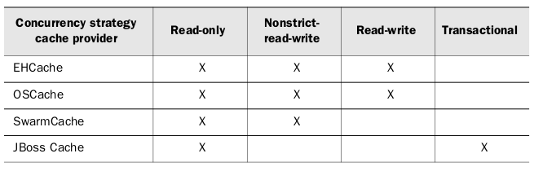
IV. Hibernate: Caching
Cache provider

Slide 30
IV. Hibernate: Get/Load
Fetch data from DB. Get entity by primary key (usually ID) + Class/EntityName
Diff
GET: id not found -> return null
LOAD: id not found -> return an object with ID, other props -> null

Slide 31
IV. Hibernate: Save
Persist the given transient instance, first assigning a generated identifier
Cascade (CascadeType.Save-Update)
Return id
Create new row if save detached object

Slide 32
IV. Hibernate: Persist
Make a transient object persistent
Cascade (CascadeType.PERSIST)
Return type Void
Throw PersistentObjectException if persist detached object

Slide 33
IV. Hibernate: Merge
main intention: copy a persistent entity instance with new field values from a detached entity instance
this operation cascades for all relations with cascade=MERGE or cascade=ALL mapping
Steps:
finds an entity instance by id taken from the passed object, create new one if find no id matched
copies fields from the passed object to this instance
returns newly updated instance

Slide 34
IV. Hibernate: Update
transitions the passed object from detached to persistent state
throws an exception if you pass a transient entity
if already that session has a persistent object with the same primary key then hibernate throws an Exception whenever update() method is called to reattach a detached object

Slide 35
IV. Hibernate: Projection
Hibernate Projections are used in order to
query only a subset of the attributes of an entity or group of entities
group the data and use aggregate functions

Slide 36
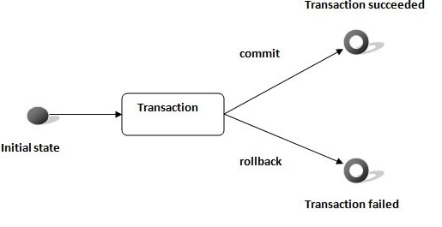
IV. Hibernate: Transaction
units of work that allow correct recovery from failures and keep a database consistent even in cases of system failure

Slide 37
IV. Hibernate: Transaction Rule
Atomicity: Each transaction should be carried out in its entirety; if one part of the transaction fails, then the whole transaction fails.
Consistency: only valid data will be written to the database.
Isolation: requires that multiple transactions occurring at the same time not impact each other's execution
Durability: ensures that any transaction committed to the database is not lost
Notes:
consistent: If a transaction is executed that violates the database's consistency rules, the entire transaction is rolled back, and the database is restored to a state consistent with those rules. On the other hand, if a transaction successfully executes, it takes the database from one state that is consistent with the rules to another state that is also consistent with the rules.
isolation: The isolation property does not ensure which transaction executes first—only that transactions will not interfere with each other.
durability: using database backups and transaction logs that facilitate the restoration of committed transactions despite any subsequent software or hardware failures
implement atom + dura: transaction detail is first written to a log that includes both redo and undo information
shadow-paging

Slide 38
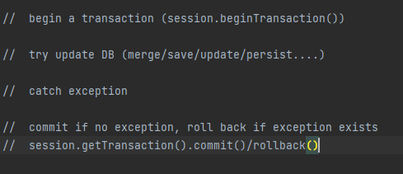
IV. Hibernate: Transaction steps in Hibernate

Slide 39
V. Spring Data JPA
What is Spring Data JPA?
Spring Data JPA is a module of Spring FrameWork. Spring Data JPA reduces the amount of boilerplate code required by JPA. That makes the implementation of your persistence layer easier and faster.
Spring Data JPA builds upon and enhances JPA.

Slide 40
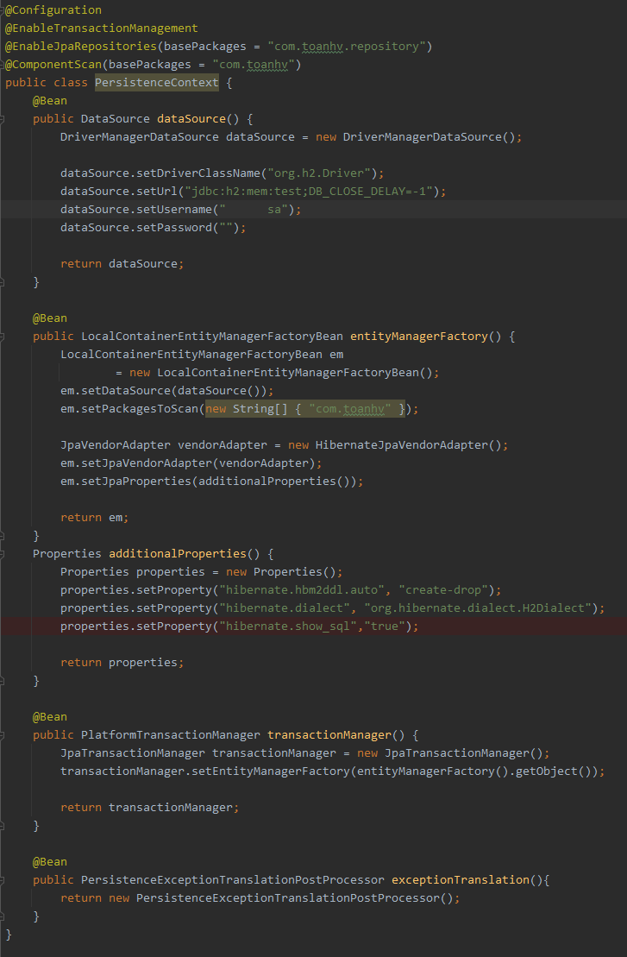
V. Spring Data JPA
Config

Slide 41
V. Spring Data JPA
2. Some Features
Create and support repositories created by Spring and JPA.
Reduce code size for generic CRUD operations by using CrudRepository.
Three kinds of Spring Data repository interfaces:
CrudRepository: provides CRUD functions
PagingAndSortingRepository: provides methods to do pagination and sort records
JpaRepository: extend CrudRepository and PagingAndSortingRepository, it also has more utility features.

Slide 42
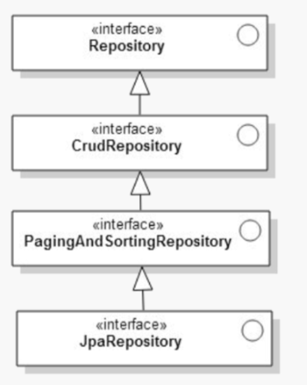

Slide 43
V. Spring Data JPA
These interfaces are associated with a JPA entity. Each JPA repository can only perform data access operations for that particular entity and its data attributes.
By supplying the JPA entity and its primary key data type, the JPA repository now knows exactly what database table.
Spring Data JPA recognizes your JPA repository and automatically generates an implementation for the DAO contract that's specified in that interface.
Notes:
Các giao diện này được liên kết với một thực thể JPA. Mỗi kho lưu trữ JPA chỉ có thể thực hiện các hoạt động truy cập dữ liệu cho thực thể cụ thể đó và các thuộc tính dữ liệu của nó
Khi bạn tạo một phương thức truy vấn, trình phân tích cú pháp truy vấn sẽ tìm kiếm các phương thức bắt đầu bằng find, query, read, count hoặc get.
Demo query by method name

Slide 44
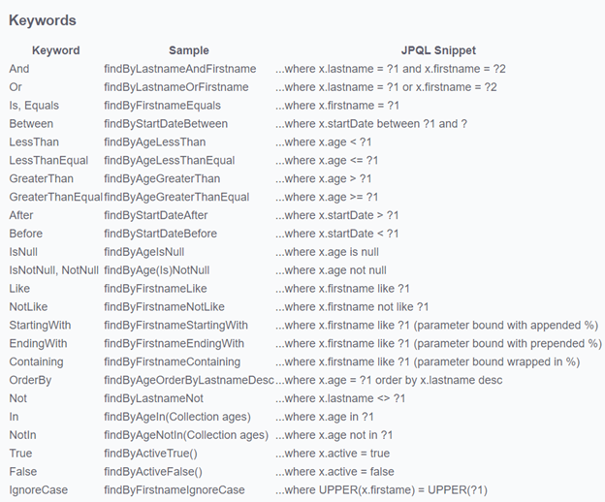

Slide 45
V. Spring Data JPA
3. Spring Data JPA vs Hibernate?
Hibernate is a JPA implementation, while Spring Data JPA is a JPA Data Access Abstraction (can generate JPA queries through method name conventions).
Spring Data JPA is not an implementation or JPA provider, it’s just an abstraction used to significantly reduce the amount of boilerplate code required to implement data access layers.
Spring Data JPA can’t work without a JPA provider, such as Hibernate, EclipseLink.

Slide 46
V. Spring Data JPA
4. @Transactional
@Transactional is way to configure Spring Transactions.
We can use @Transactional to wrap a method in a database transaction, manage the creation, commit and rollback of the transaction.
We can put it on a class or method.
Support:
The Propagation type of the transaction
The Isolation level of the transaction
The rollback rules for the transaction
Notes:
Theo mặc định, rollback xảy ra trong quá trình runtime và chỉ xảy ra khi gặp các unchecked exception
Checked exception sẽ không trigger rollback. Chúng ta cũng có thể custom lại TH rollback theo ý chúng ta.

Slide 47
V. Spring Data JPA
4. 1 Propagation
Spring manages to start, pause and create a transaction according to our propagation setting.
Types of propagation:
REQUIRED
SUPPORTS
MANDATORY
NEVER
NOT_SUPPORTED
REQUIRES_NEW
NESTED

Slide 48
V. Spring Data JPA
4. 1 Propagation
REQUIRED is the default propagation. Spring checks if there is an active transaction, and if nothing exists, it creates a new one. Otherwise, the business logic appends to the currently active transaction.
SUPPORTS, Spring first checks if an active transaction exists. If a transaction exists, then the existing transaction will be used else executed non-transactional.
MANDATORY, if there is an active transaction, then it will be used else Spring throws an exception.
NEVER, Spring throws an exceptions if there’s an active active transaction.
NOT_SUPPORTED, If a current transaction exists, first Spring suspends it, and then the business logic is executed without a transaction:
REQUIRES_NEW, Spring suspends the current transaction if it exists, and then creates a new one.
NESTED,Spring checks if a transaction exists,it marks a save point.This means that if our business logic execution throws an exception, then the transaction rollbacks to this save point. If there's no active transaction, it works like REQUIRED.

Slide 49
V. Spring Data JPA
4.2 Transaction Isolation
Isolation is one of the common ACID properties
Isolation describes how changes applied by concurrent transactions are visible to each other.
Concurrency side effects on a transaction:
Dirty read
Non-repeatable read
Phantom read

Slide 50
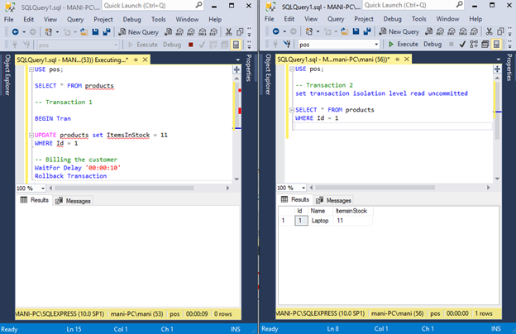

Slide 51
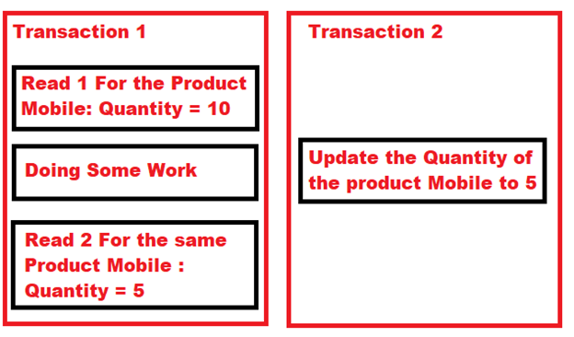
Notes:
get different value khi đọc lại 1 hàng nếu 1 concurrent transaction cập nhật cùng 1 hàng và đã commit.

Slide 52
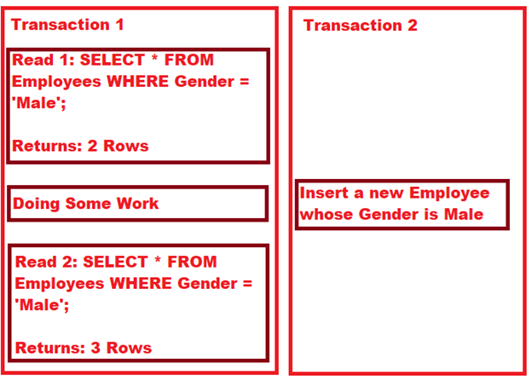
Notes:
Nhận các hàng khác nhau sau khi thực hiện lại 1 query, nếu có 1 transaction nào khác thêm hoặc remove some rows và commit.

Slide 53
V. Spring Data JPA
4 level Isolation:
READ_UNCOMMITTED is the lowest isolation level and allows for the most concurrent access.
READ_COMMITTED is the second level of isolation, prevents dirty reads.
REPEATABLE_READ is the third level of isolation,prevents dirty and non-repeatable reads.
SERIALIZABLE is is the highest level of isolation. It prevents all mentioned concurrency side effects, but can lead to the lowest concurrent access rate because it executes concurrent calls sequentially.
Notes:
READ_UNCOMMITTED: là isolation cấp thấp nhất cho phép nhiều truy cập đồng thời nên nó bị cả 3 side effects đề cập ở trên. Cái transaction với isolation này có thể đọc dữ liệu chưa được commit của các concurrent transaction khác và cả non-repeatable và phantom read. Như vậy, chúng ta có thể nhận được một kết quả khác khi đọc lại một hàng hoặc thực hiện lại một truy vấn phạm vi.
Những thay đổi chưa đc commit trong concurrent transaction khác thì không ảnh hưởng, nhưng kết quả sẽ bị thay đổi nếu query lại. READ_COMMITTED is the default level with Postgres, SQL Server, and Oracle.
Cho nên không bị ảnh hưởng bởi các thay đổi chưa đc commit trong các transaction đồng thời và khi chúng ta re-query 1 row , chúng ta cũng sẽ không nhận 1 giá trị khác. Tuy nhiên khi thực hiện truy vấn trên 1 phạm vi thì có thể get được các hàng mới hoặc 1 số hàng sẽ bị xoá đi. REPEATABLE_READ is the default level in Mysql. Oracle does not support REPEATABLE_READ.

Slide 54
V. Spring Data JPA
4.3 Transaction Rollback
The @Transactional annotation makes use of the attributes rollbackFor or rollbackForClassName to rollback the transactions, and the attributes noRollbackFor or noRollbackForClassName to avoid rollback on listed exceptions.
The default rollback behavior of @Transactional will rollback on unchecked exceptions.

Slide 55
V. Spring Data JPA
5. Some Common Pitfall
N+1 SELECT problem is probably the most known and common problem for all Object-Relational Mapping tools which support lazy loading.
N+1 SELECT vulnerability may cause noticeable performance issues.
Solution:
FetchType.EAGER replace for lazy-loading
@BatchSize(size = ...)
Join Fetch, EntityGraph,...
Notes:
Vấn đề đặt ra: Ví dụ chúng ta có 1000 Room mỗi Room lại có 1 vài Item, khi chúng ta lấy ra 1000 Room đó thì chỉ mất 1 câu query nhưng khi access vào các Item của mỗi Room thì khi đó nó lại tạo ra 1 câu query và tổng query là 1001 câu, điều này là không cần thiết vì chúng ta hoàn toàn có thể xử lý điều này bằng 1 hoặc 2 câu
@BatchSize nó nói vs Hibernate rằng thay vì lazy init từng cái 1 khi chúng đc truy cập, thì nó sẽ init M cái khi chúng ta truy cập 1 cái => số câu truy vấn là N/M + 1. => chưa phải cách tốt nhất
Ý tưởng đằng sau Join Fetch, EntityGraph là tránh việc set eager fetching trên entity class mà thực hiện điều đó cho từng TH. Vì vậy mặc định ban đầu chúng sẽ là lazy loading và trong từng TH cụ thể thì một trong số đó nên được load eager.

Slide 56
V. Spring Data JPA
5. Some Common Pitfall
Redundant @Transaction or JPA calls: This isn’t actually a serious mistake, but it instantly reveals that the author wasn’t sure about how @Transactional works.
@Transaction Ignored: 2 condition make @Transaction works
This method must be public.
The invocation must come from outside of the bean.
This is due to how Spring proxying work by default (using CGLIB proxies).
Notes:
Khi 1 method được đánh dấu transactional, entity được truy xuất trong transaction này ở trong trạng thái được quản lý, điều này có nghĩa là mọi cái thay đổi của entity sẽ tự động được đưa vào CSDL khi transaction kết thúc.
Khi chúng ta autowired 1 bean nào đó thì thực tế Spring sẽ không cung cấp cho chúng ta chính xác 1 instance của bean đó. Thay vào đó nó inject 1 proxy extend bean đó và ghi đè các public method để thêm các hành vi bổ sung (như wrap vào 1 transaction với @Transactional).

Slide 57
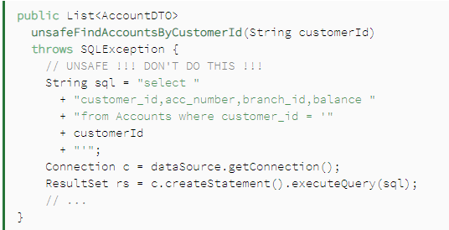
V. Spring Data JPA
5. Some Common Pitfall
SQL Injection
If we take the data from the customer to feed into the query without being careful, then our application can be attacked by hackers.

Slide 58
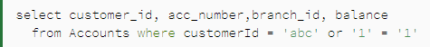
V. Spring Data JPA
5. Some Common Pitfall
SQL Injection

Slide 59
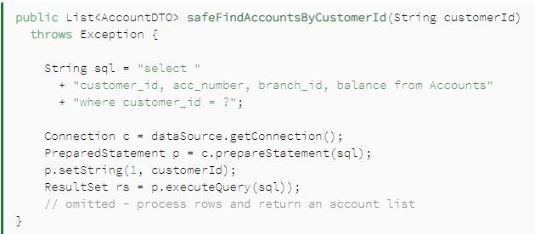
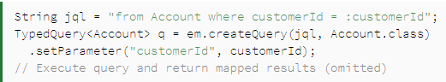
V. Spring Data JPA
5. Some Common Pitfall
SQL Injection: Prevent Techniques
Parameterized queries:
Notes:
Ở đây chúng ta sử dụng prepareStatement() có sẵn trong Connection để lấy ra 1 PrepareStatement. cho phép chúng ta chèn các giá trị do người dùng cung cấp một cách an toàn vào một truy vấn trước khi thực thi nó.

Slide 60
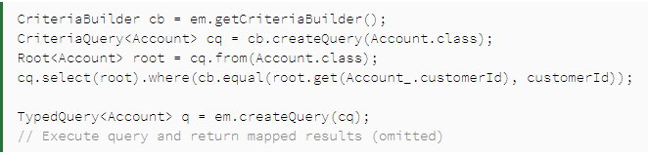
V. Spring Data JPA
5. Some Common Pitfall
SQL Injection: Prevent Techniques
JPA Criteria API

Slide 61
V. Spring Data JPA
5. Some Common Pitfall
SQL Injection: Prevent Techniques
User Data Sanitation: Data Sanitation is a technique of applying a filter to user supplied-data so it can be safely used by other parts of our application.
A filter's implementation may vary a lot, but we can generally classify them in two types: whitelists and blacklists.
Blacklists, which consist of filters that try to identify an invalid pattern.
Whitelists, on the other hand, work particularly well when we can define exactly what is a valid input
Notes:
Data Sanitization là kỹ thuật áp dụng bộ lọc cho dữ liệu do người dùng cung cấp để các phần khác trong ứng dụng của chúng tôi có thể sử dụng một cách an toàn
Danh sách đen, bao gồm các bộ lọc cố gắng xác định một mẫu không hợp lệ.
Danh sách trắng, mặt khác, làm việc đặc biệt tốt khi chúng ta có thể xác định chính xác những gì là đầu vào hợp lệ

Slide 62


